Slide 1
Application Architecture

Slide 2
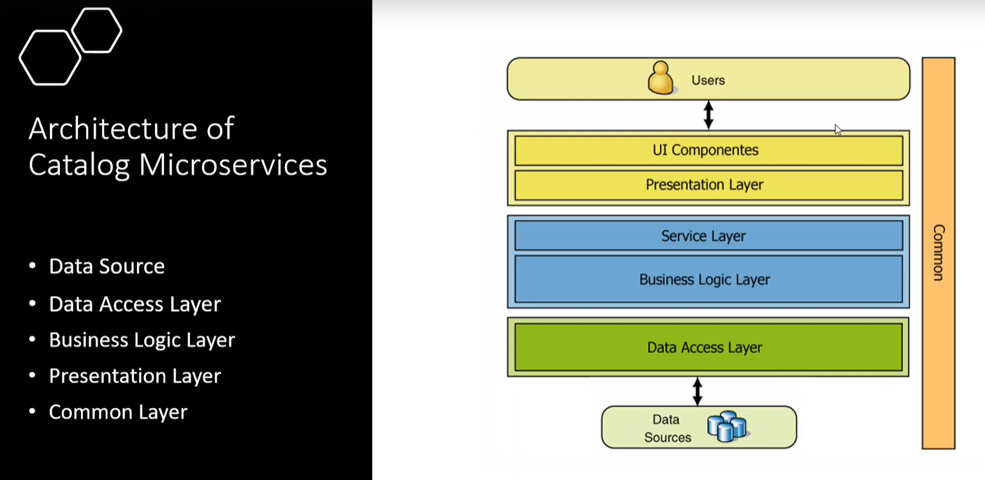

Slide 3
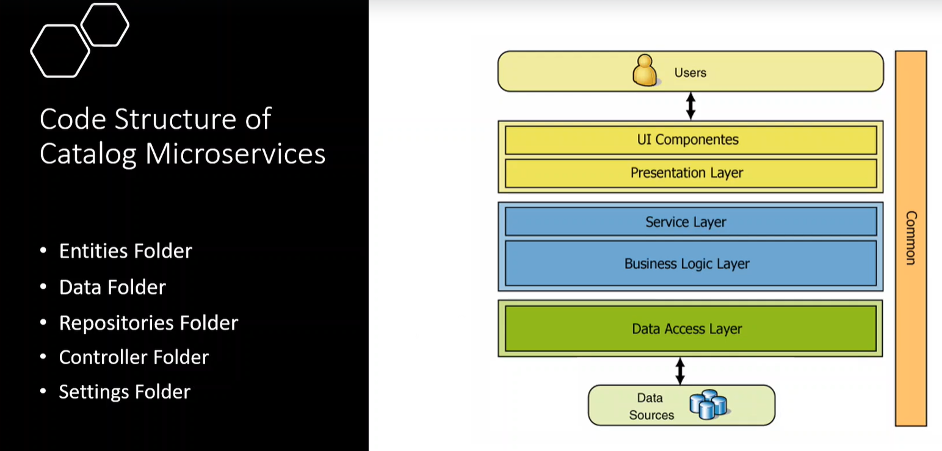

Slide 4
